Slide 1

Mechanism For Eye Blink Detection

Slide 2
Our Group
01
E.M.S.D. Vidyakeerthi - 16001508
02
W.W. Daluwatta - 16000226
03
N.M.H Savindra - 16020792
04
P.D.N.C Pathiraja - 16001028
05
O.K Senanayake - 16020804

Slide 3

Introduction
Our goal was to build a image recognition system that can identify when eye blinking happens.
In current society there are so many major image process techniques & artificial neural networks to;
Face detection.
Face segmentation.
Edge detection.
Eye detection & etc.

Slide 4

Our Solution
We used extensive image processing tools ;
OpenCV python library.
Python 3.7
dlib / numpy python libraries.
Pre-trained face/eye detection module file.

Slide 5

Our Solution cont.
Our solution was involved major functions of the image processing
Image segmentation (Image thresholding)
Image smoothing
Contour detection
Our programme will more accurate in less noisy images when images are static. And for the blink counting programme the image smoothing section is not included as it takes high computing power for demonstration.

Slide 6
Our Solution cont.
Our algorithm for image processing attempt, basically can be divided into four parts.
Detection
Classification
Recognition
Decision

Slide 7
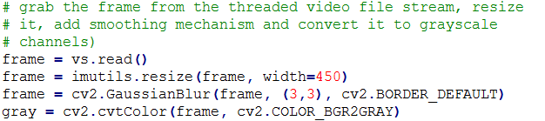
Detection
When user input the image as a parameter the programme automatically identify the face from the given image by ignoring the other objects. So it happens in the following way
Read the image.
Resize the image.
Add gaussian smoothing for some noise cancelation.
Convert the image into grayscale.
Use the pre trained model to identify the image from the processed image.

Slide 8
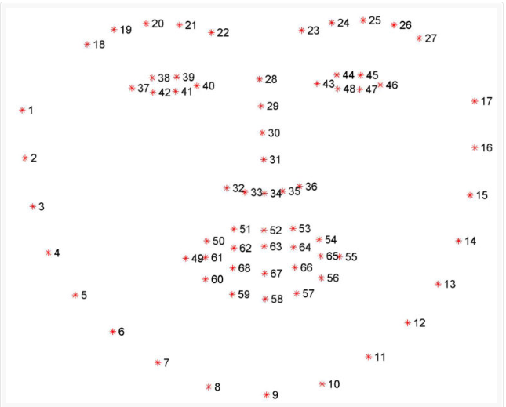
Classification
So the programme can identify the face objects such as eyes, nose, mouth etc independently. But in here we only concern about the eyes of a given image. So classification would happen on the following order.
Take the facial landmarks from the detection algorithm
Find the eye related pixel points from the landmark array
Take the left eye and right eye from the array filtering using the label name

Slide 9
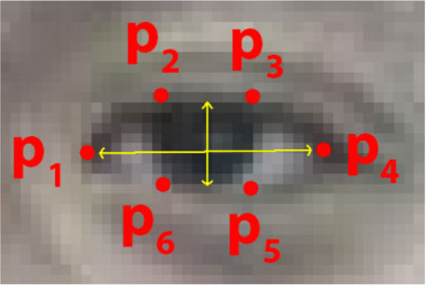
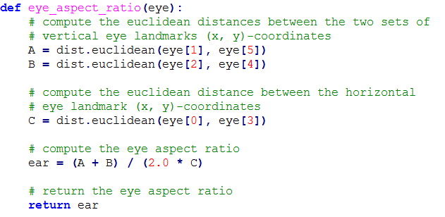
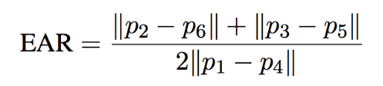
Recognition
So now we know where the eyes are and now we only have to find whether the eyes are opened or closed in order to find the eye blink. So it would happen in following way,
Calculate the eye aspect ratio (EAR) using the eyes’ pixel values
Check whether the EAR is less than or greater than to the threshold value (in here we use a static image to process. So the threshold value T is 0.25)
If EAR > T eye is opened, otherwise not.

Slide 10
Decision
So based on the EAR value we can take the decision whether the eyes are opened or not. So we carry out those steps to a static image to find whether the eyes are opened or not. But to detect eye blinks we have to use a video stream. So we modified the algorithm to take the image frame from a video stream.
Basic Changes;
Capture the image frame wise.
Resize the image and use that image for processing.
If an one image frame’s EAR is less than to the threshold value we increment the eye blink by one.
Likewise loop through the video stream until it finish and count the eye blinks.

Slide 11

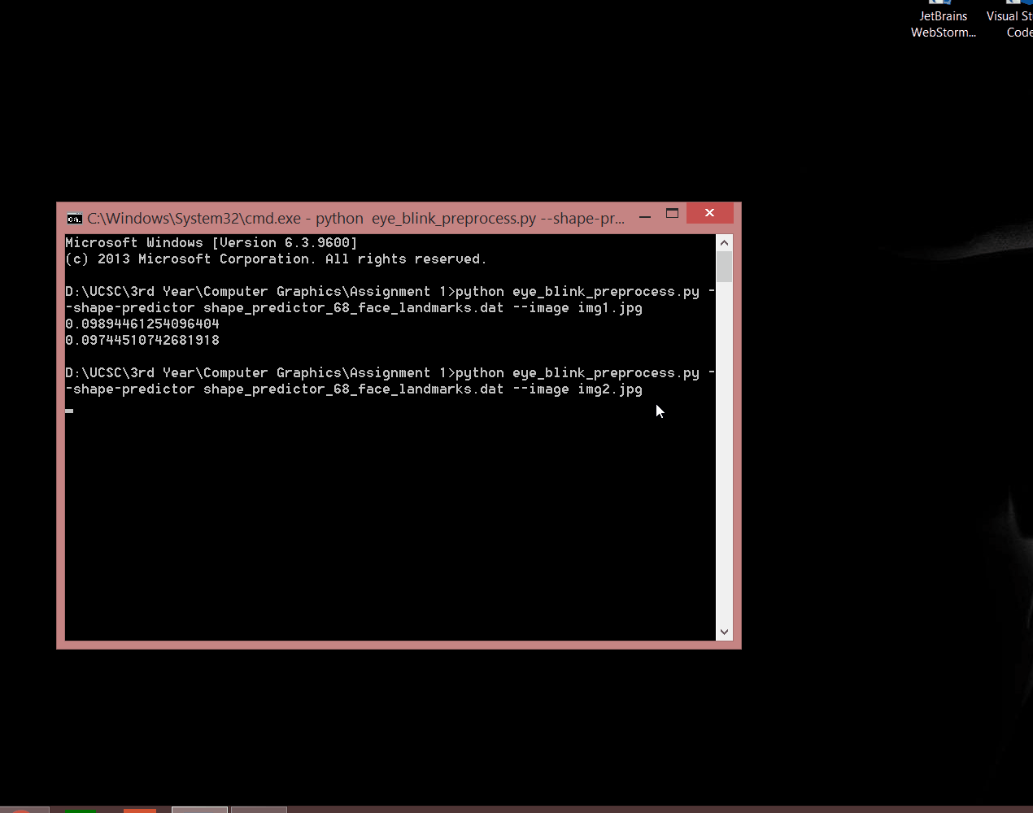
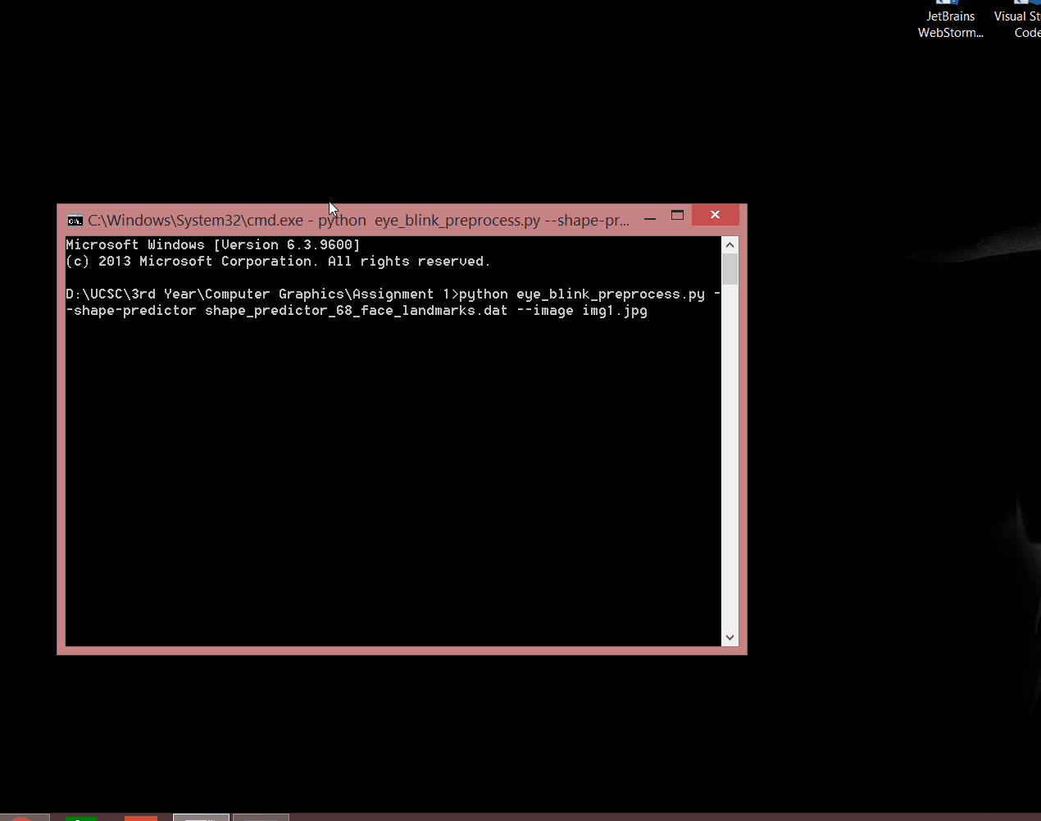
Examples

Slide 12
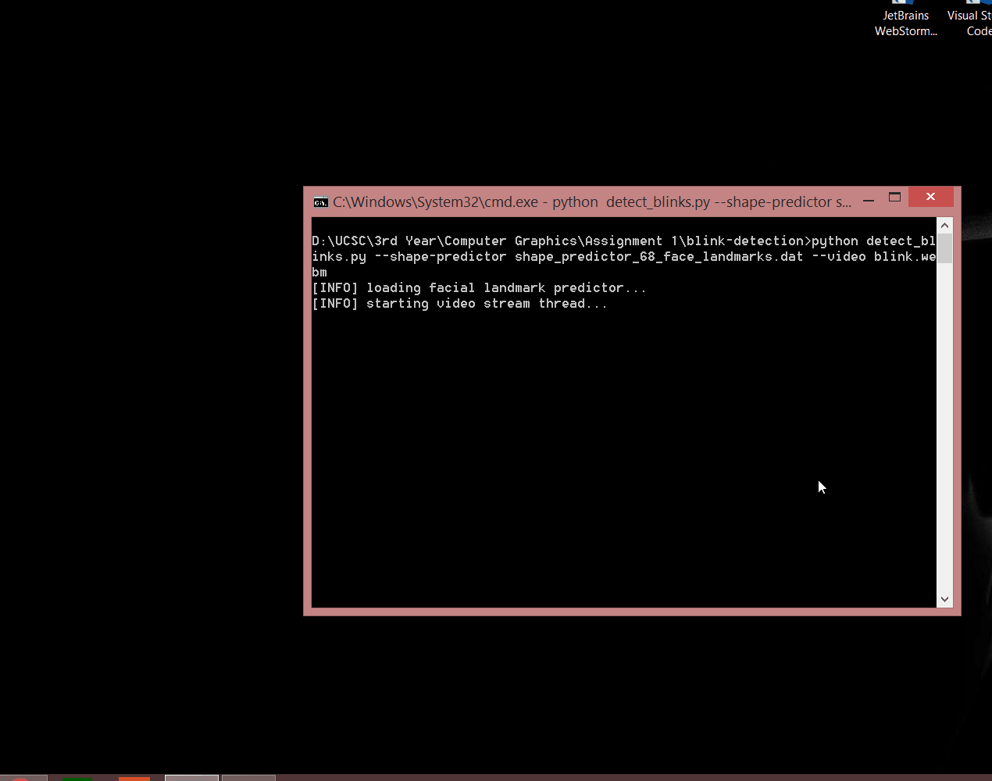

Slide 13
Demonstration

Slide 14
Thank You !

